Slide 1

Modeller
Vilken ska man välja

Slide 2
Agenda
R2 repetition
Data genomgång
Jämföra regressionsmodeller
Score - Regression
Accuracy - Classification

Slide 3
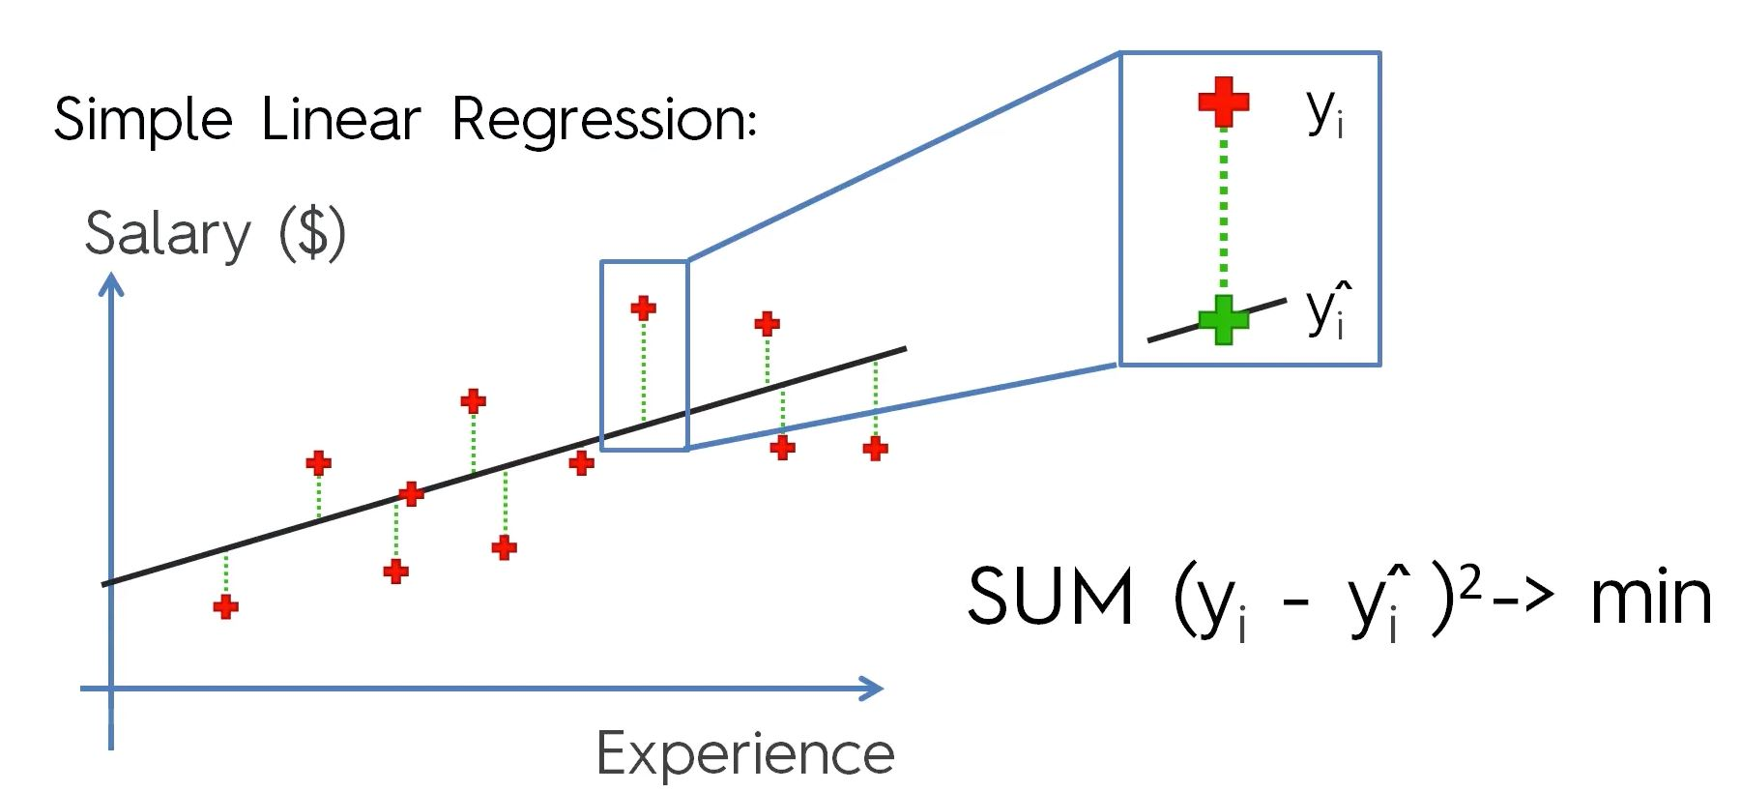
R2
Måttet R2 tas fram intuitivt på samma sätt som minimeringen av avståndet till punkter vid linjär regression.
Måste anpassas för att straffa tillagda frihetsgrader.
Sum of squares of residuals
Total sum of squares
Definition av måttet R2

Slide 4
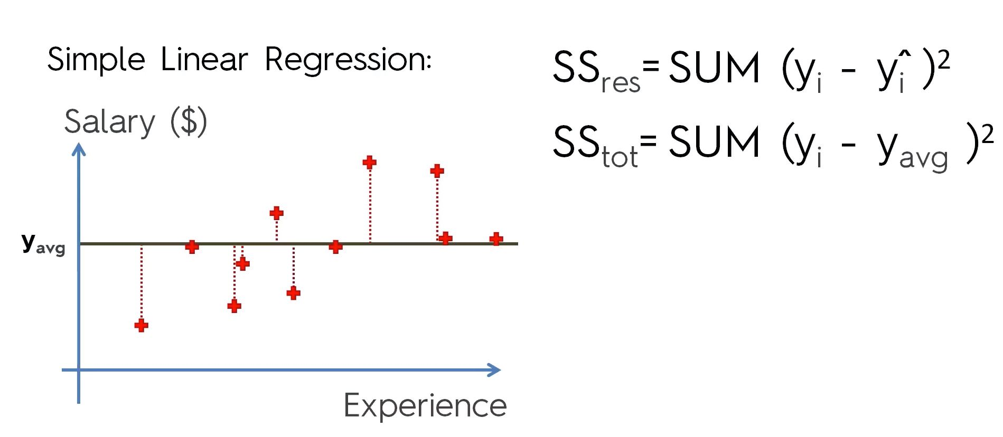
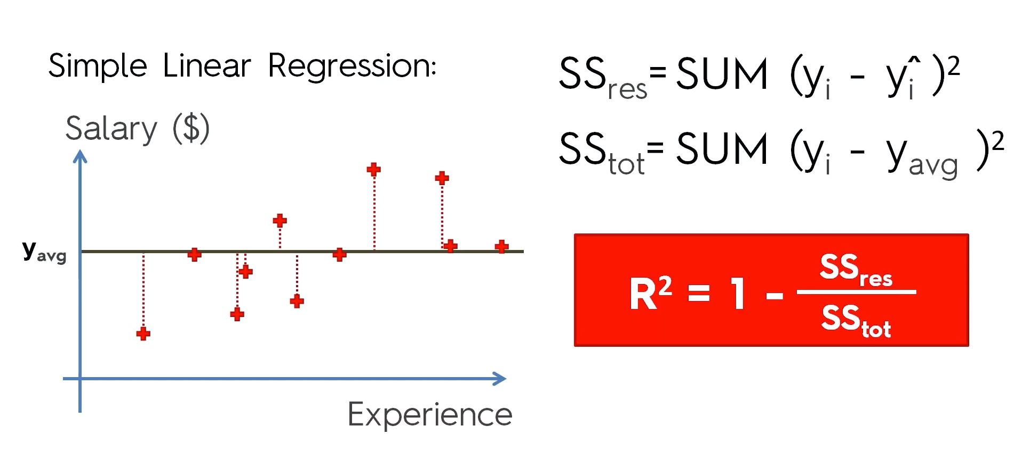
R2 - matten

Slide 5
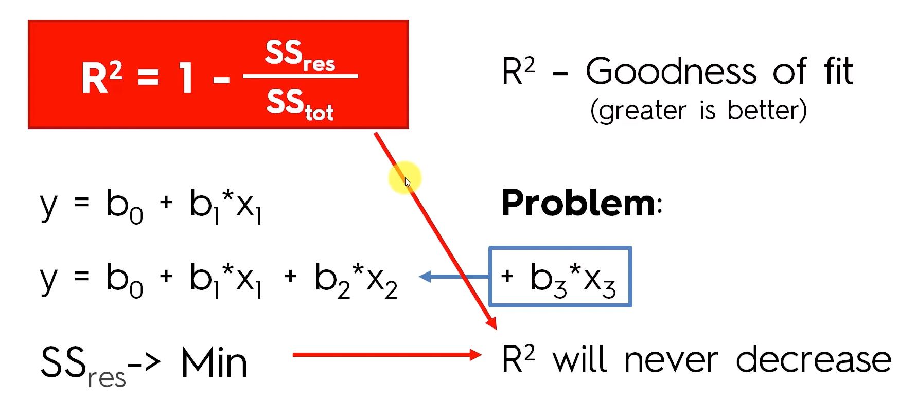
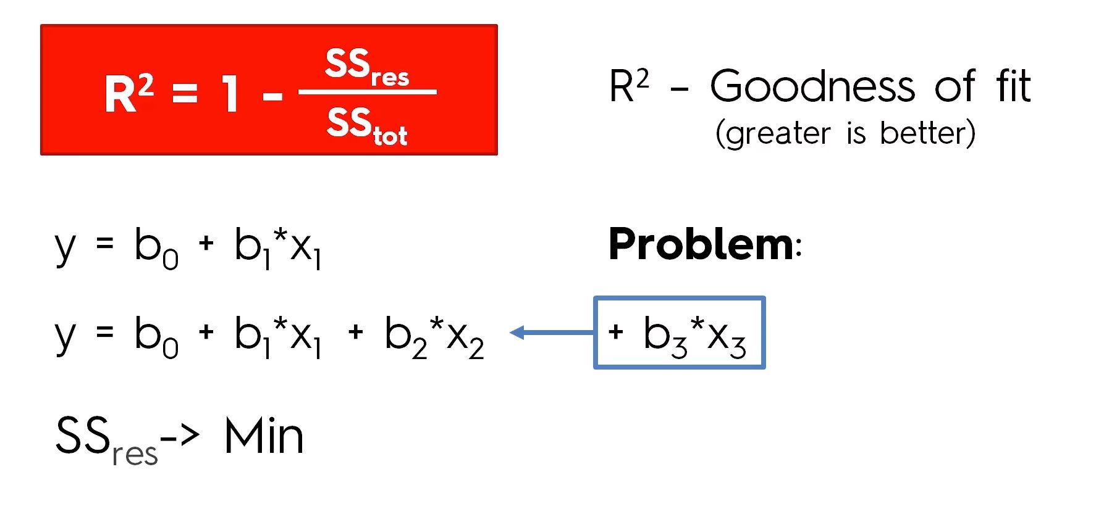
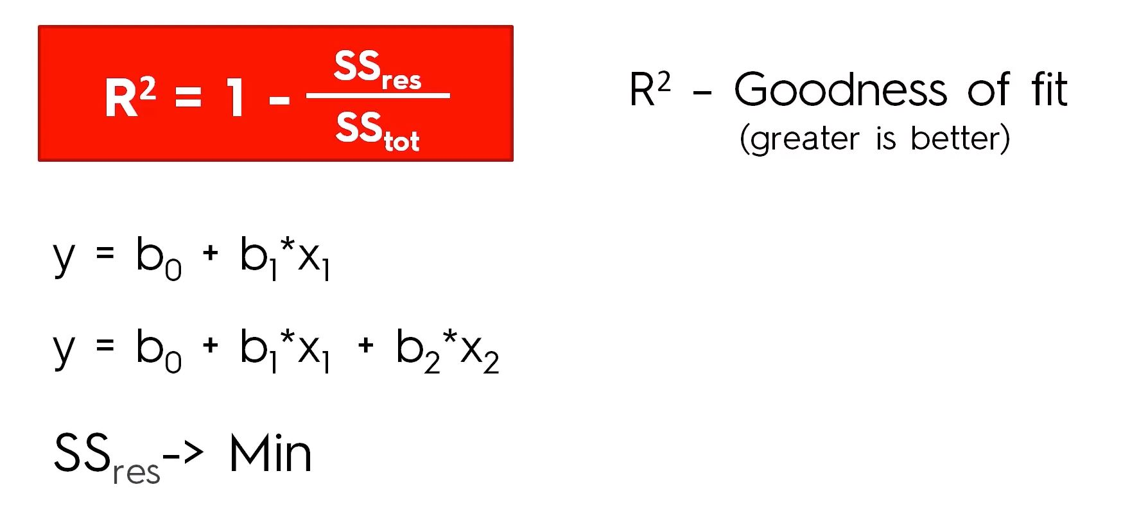
R2 - anpassat
Man kan aldrig försämra R2 genom att lägga till en oberoende variabel.
Anpassat R2 konstrueras så att en ny variabel / frihetsgrad måste bidra konkret till modellens förbättring.
I anpassat R2 finns en bestraffning inbyggd för att inkludera variabler som inte hjälper modellen.
https://en.wikipedia.org/wiki/Coefficient_of_determination#Adjusted_R2

Slide 6
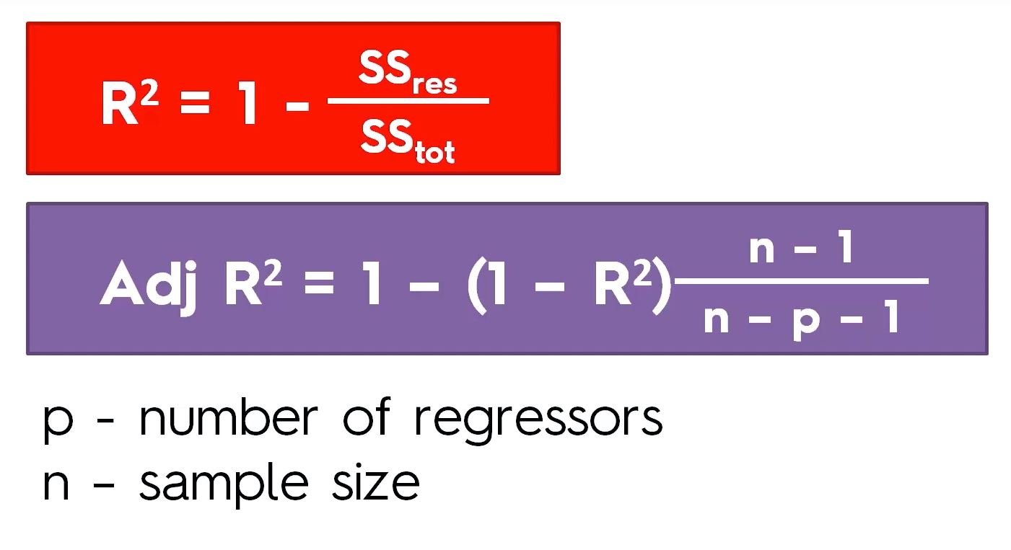
R2 - Adjusted

Slide 7
Real data - Power plant example
Features consist of hourly average ambient variables
Temperature (T) in the range 1.81°C and 37.11°C,
Ambient Pressure (AP) in the range 992.89-1033.30 millibar,
Relative Humidity (RH) in the range 25.56% to 100.16%
Exhaust Vacuum (V) in the range 25.36-81.56 cm Hg
Net hourly electrical energy output (EP) 420.26-495.76 MW
The averages are taken from various sensors located around the plant that record the ambient variables every second. The variables are given without normalization.
UCI Machine Learning Repository - Combined Cycle Power Plant

Slide 8
Jämföra regressionsmodeller
Regression | Data set size | Non-linear | Pros | Cons
Linear | Any | No | Info on feature relevance
Polynomial | Any | Yes |  | Bias/Variance tradeoff in degree selection
SVR | Any | Yes | Not biased by outliers | Must scale features Difficult to understand
Decision Tree | Medium+ | Yes | Interpretability | Overfits easily Dataset size is very important
Random Forest | Medium+ | Yes | Powerful and accurate Many problems | No interpretability Correct number of trees Overfits easily

Slide 9
Länkar
Scikit metrics - r2 score
Scikit metrics - regression
Scikit metrics - Model evaluation
R2 värdet - en annan förklarning
Mer om Decision Trees i python
UCI ML Repository

